Slide 1
Phase 5 digraphs.
Your child can use this PowerPoint to think of words containing the phase 5 sounds. Choose a couple of sounds to focus on a day.
They could say the words, write the words or draw pictures of words containing that sound.

Slide 2
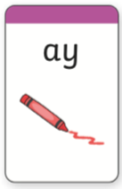
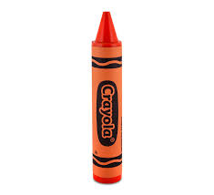
How many words can you think
of containing this digraph?
day
lay
crayon
play
spray

Slide 3
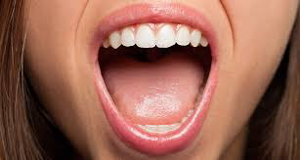
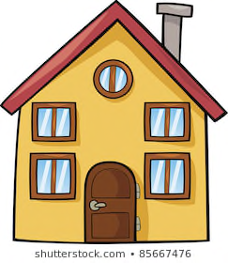
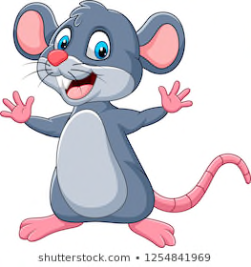
How many words can you think
of containing this digraph?
cloud
mouth
outside
house
mouse

Slide 4
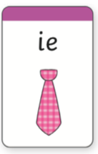
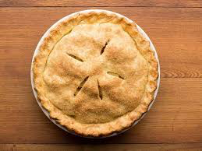
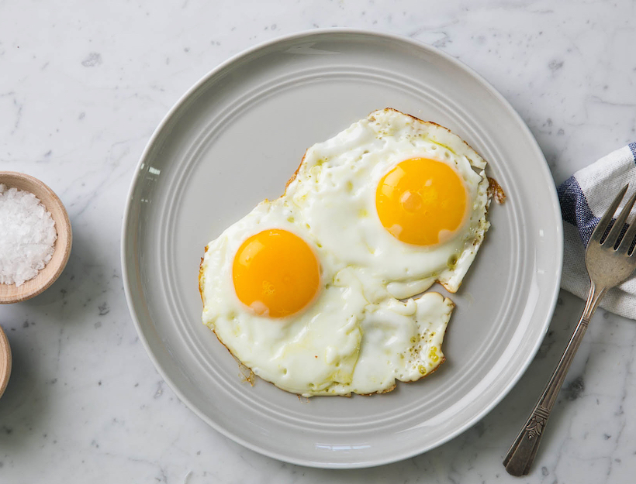
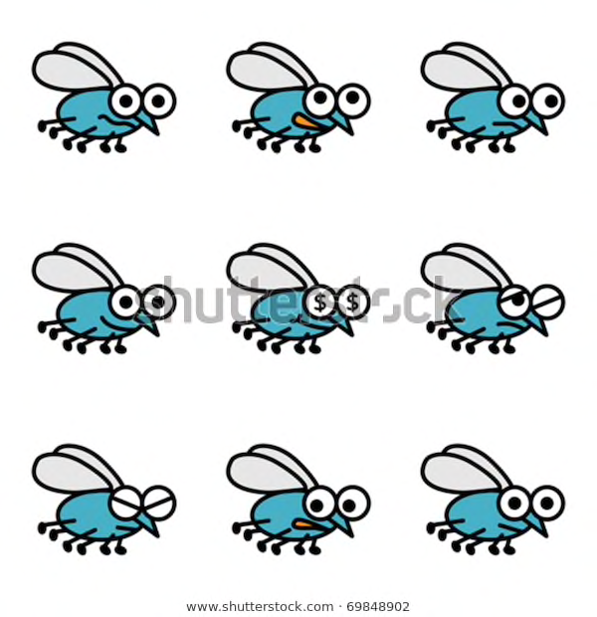
How many words can you think
of containing this digraph?
fried
flies
pie
tie
cried

Slide 5
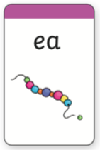
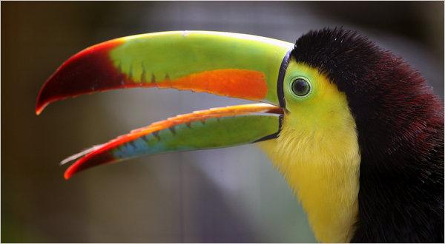
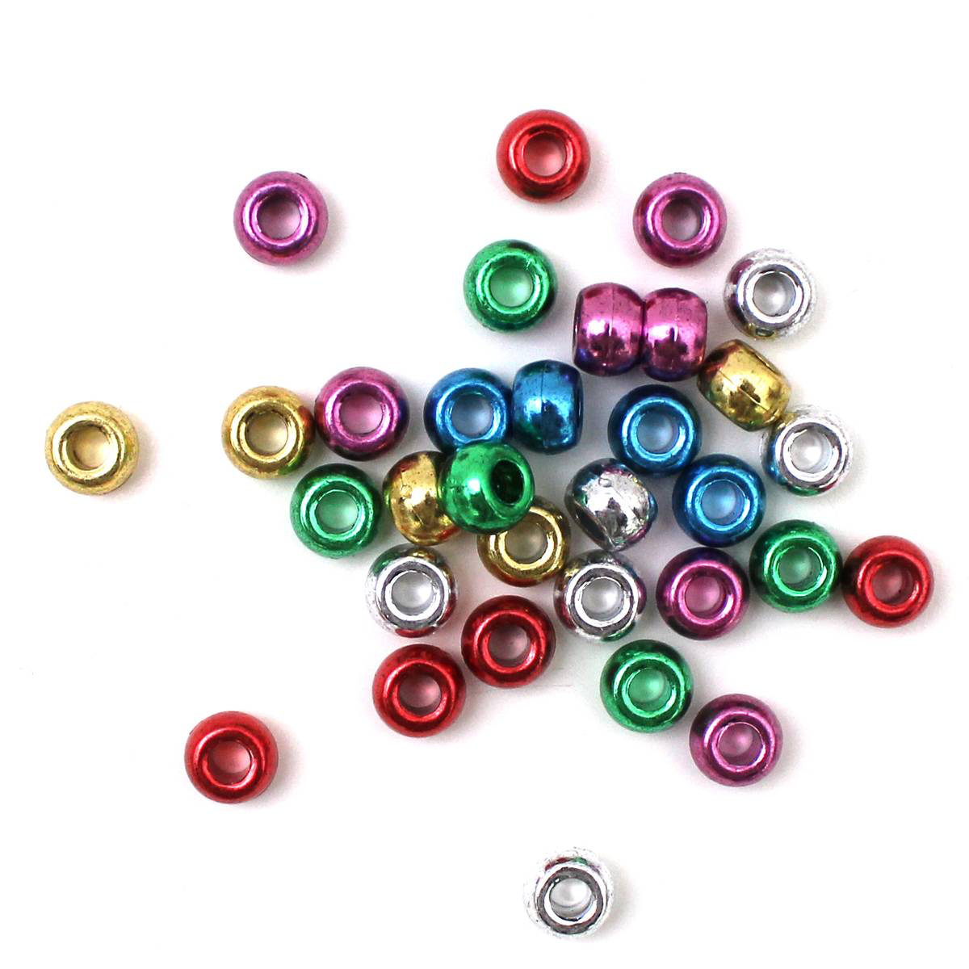
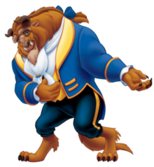
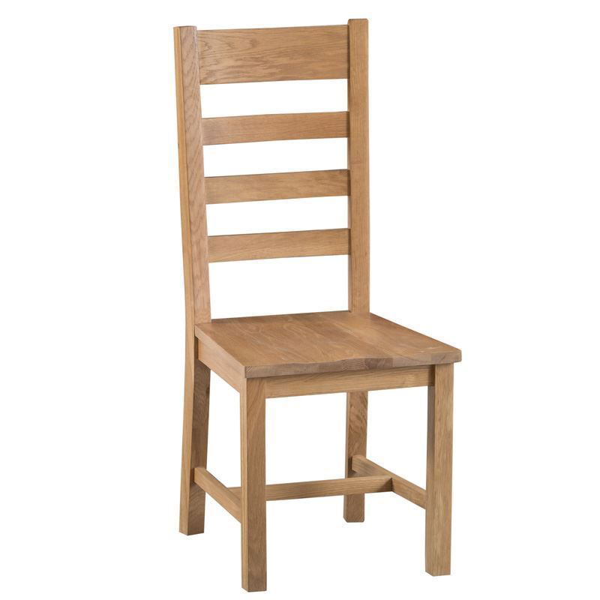
How many words can you think
of containing this digraph?
beads
team
beak
beast
seat

Slide 6
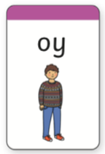
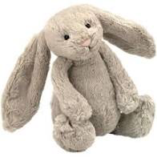
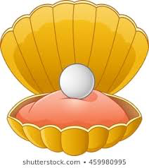
How many words can you think
of containing this digraph?
boy
enjoy
toy
royal
oyster

Slide 7
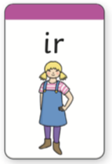
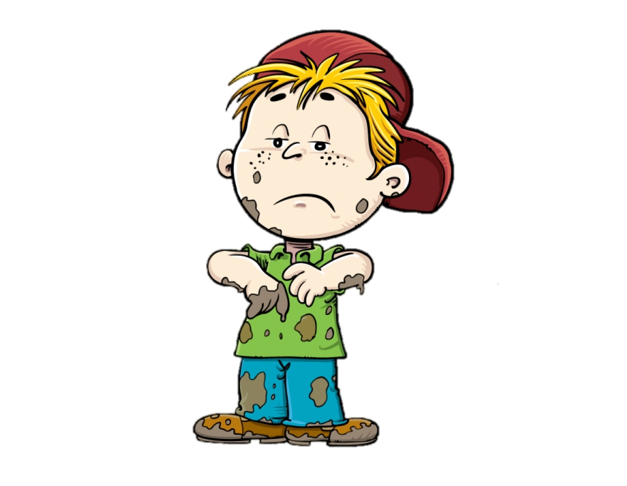
How many words can you think
of containing this digraph?
bird
stir
girl
shirt
dirty

Slide 8
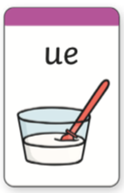
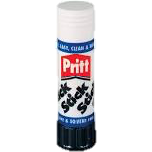
How many words can you think
of containing this digraph?
glue
true
blue
clue

Slide 9
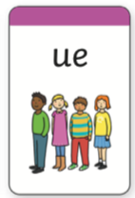
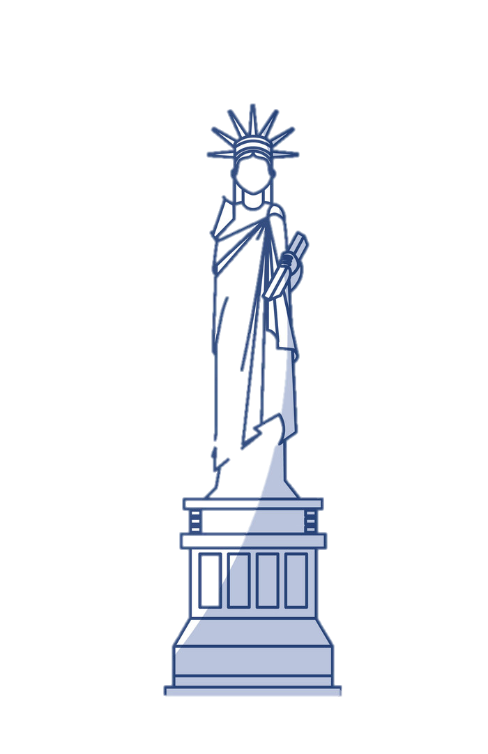
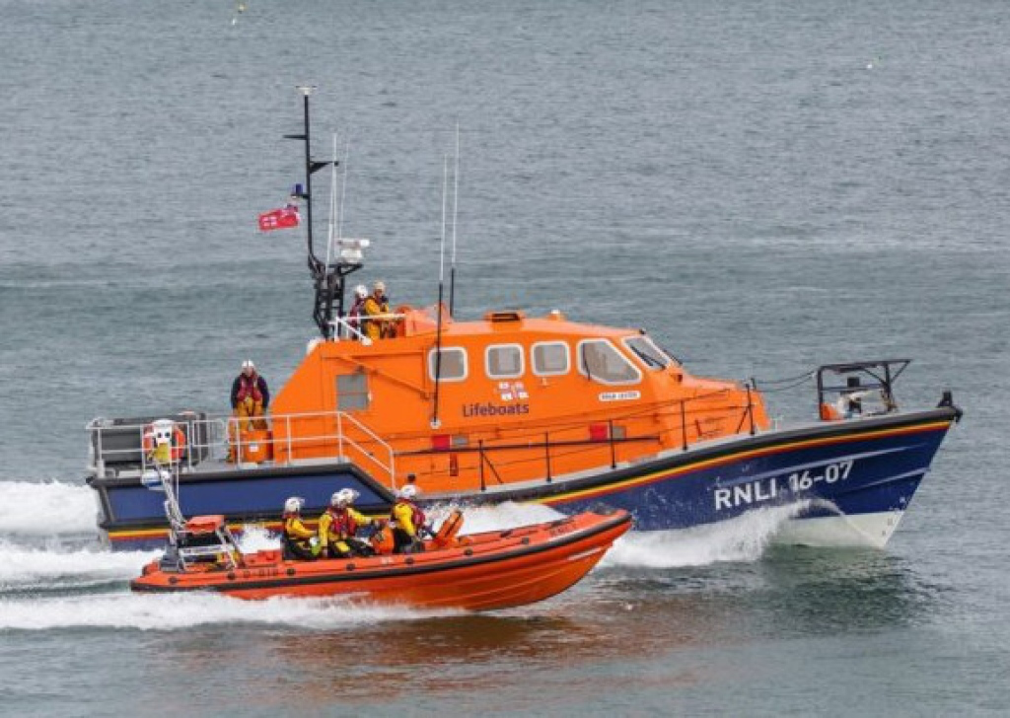
How many words can you think
of containing this digraph?
rescue
statue
argue
barbeque
tissue

Slide 10
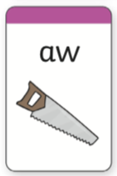
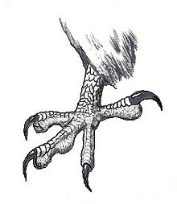
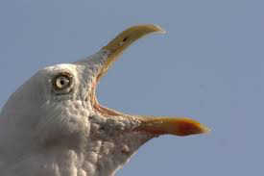
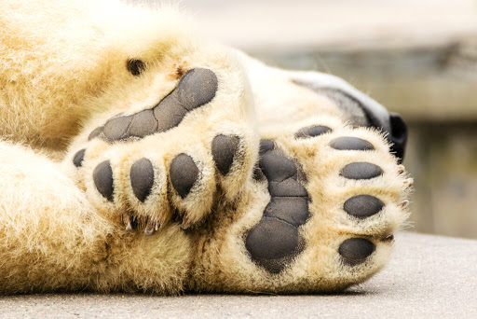
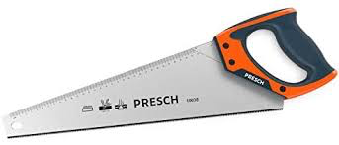
How many words can you think
of containing this digraph?
claw
squawk
lawn
paw
saw

Slide 11
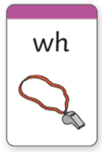
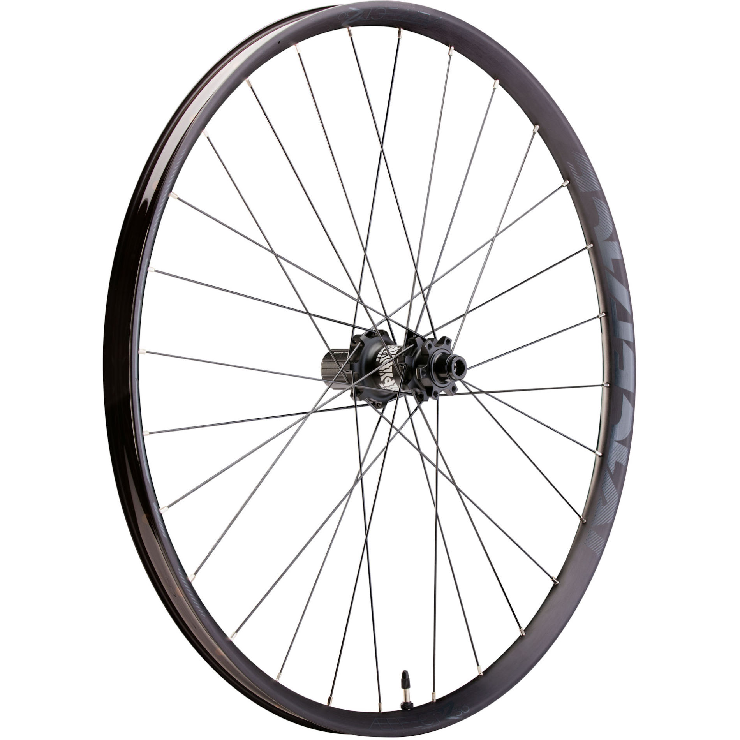
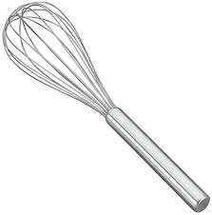
How many words can you think
of containing this digraph?
whale
whisk
wheel
whisper
white

Slide 12
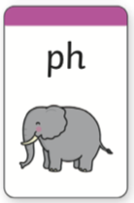
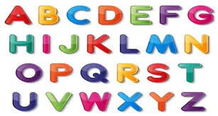
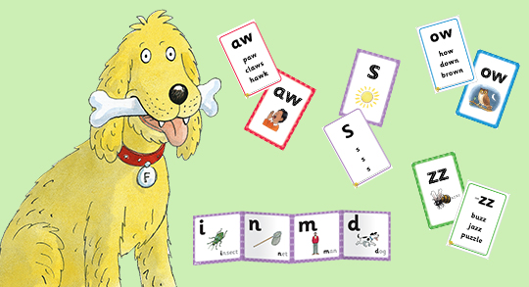
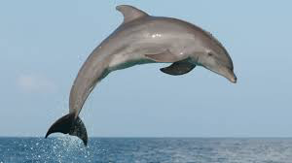
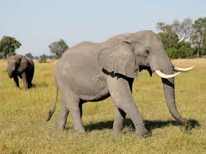
How many words can you think
of containing this digraph?
alphabet
phonics
phone
dolphin
elephant

Slide 13
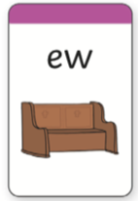
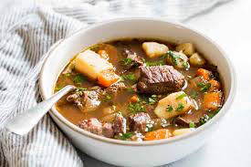
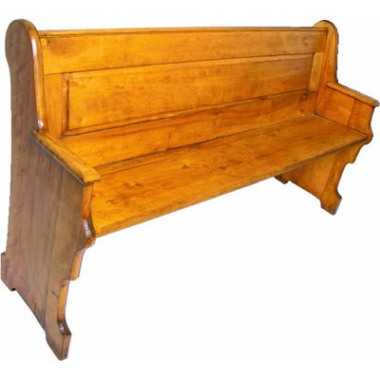
How many words can you think
of containing this digraph?
stew
pew

Slide 14
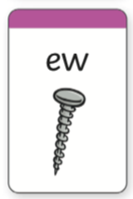
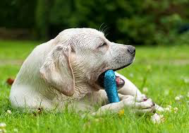
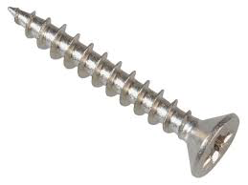
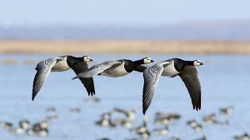
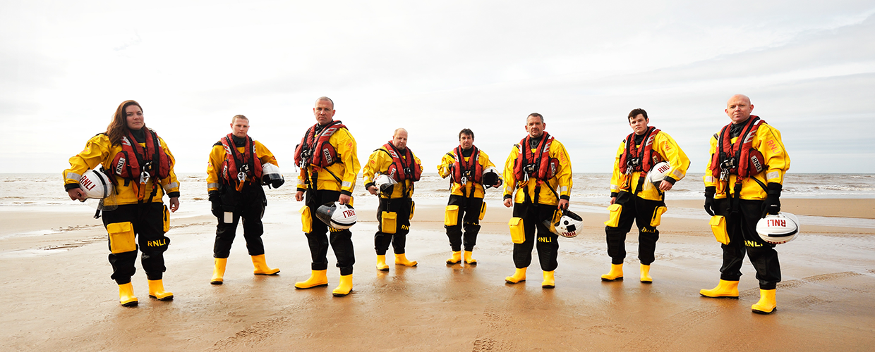
How many words can you think
of containing this digraph?
screw
chew
crew
flew

Slide 15
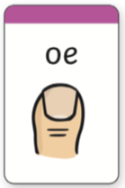
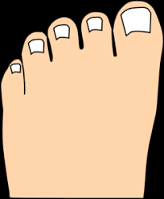
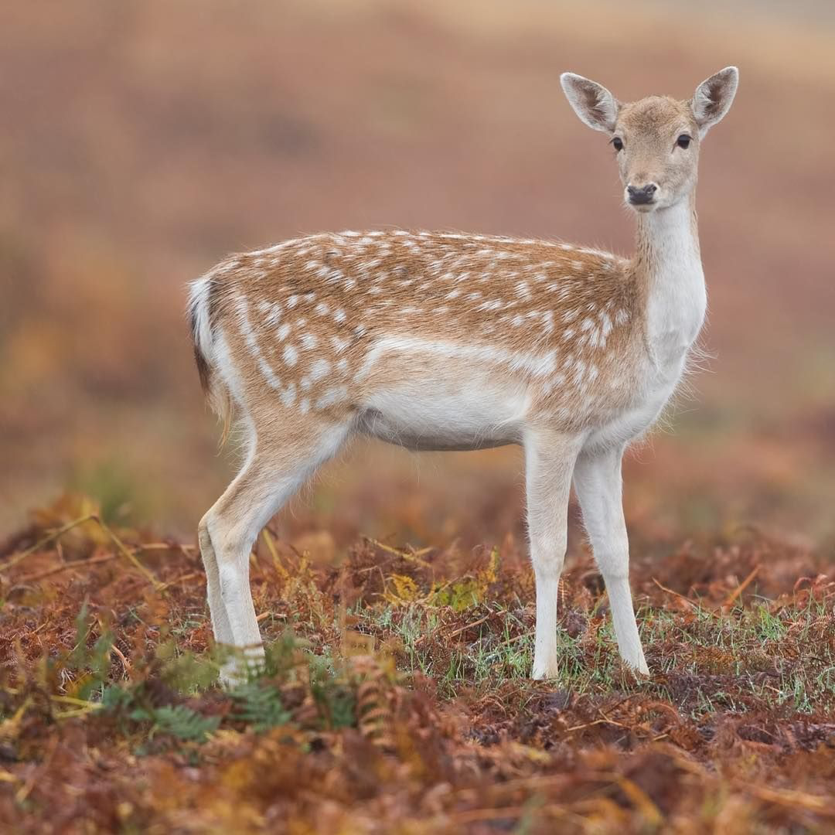
How many words can you think
of containing this digraph?
toes
doe
goes

Slide 16
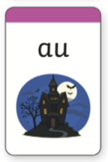
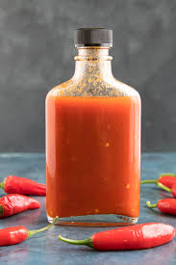
How many words can you think
of containing this digraph?
sauce
launch
author
August
pause

Slide 17
How many words can you think
of containing this digraph?
monkey
turkey
money
chimney
keys

Slide 18
How many words can you think
of containing this split digraph?
games
rake
snake
spade
cupcake

Slide 19
How many words can you think
of containing this split digraph?
even
concrete
theme
these

Slide 20
How many words can you think
of containing this split digraph?
slide
bike
five
kite
fine

Slide 21
How many words can you think
of containing this split digraph?
bone
cone
smoke
nose
home

Slide 22
How many words can you think
of containing this split digraph?
flute
rude
prune
June

Slide 23
How many words can you think
of containing this split digraph?
cube
dune
tube
cute

